Slide 1
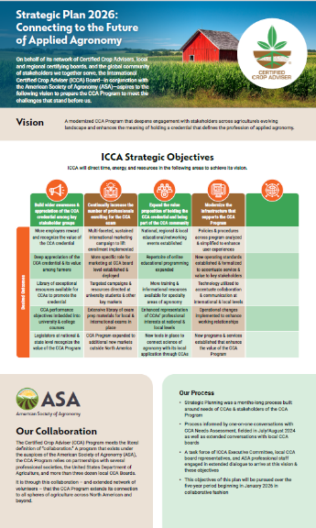

Connecting to the Future of Applied Agronomy
The ASA 2026-31 Strategic Plan

Slide 2
Inputs into Process
CCA Needs Analysis
(Summer ‘24)
Perspectives of CCA Boards from 1:1 conversations (Lara Bryant)
Perspectives of Professional Staff
Extensive Strategic-Planning Task Force Dialogue
ICCA Board Meeting in August
Notes:
If what I said is true, that the process is more important than the plan, I want to assure you that we have been as inclusive as possible, this to ensure that we are building our strategic objectives around the understood and articulated needs of all our stakeholders – including everyone on this call.
This began last summer when we did a needs assessment of our current population of CCAs.
A few months ago, we hired Lara Bryan as our new Associated Director of Component Relations, and she’s spent a lot of time over the time since she’s been here talking one-on-one with local CCA boards … we’ll be baking what she’s heard from you into our process
We’ll likewise lean on the perspectives of our professional staff, particularly those with day-to-day involvement w/ the CCA Program
Of course, we’ve held extensive dialogue with the strategic-planning task force, which helps to put all of this into perspective
And of course, we’ll present you with the plan in August, refine it as necessary, and likewise use your feedback to ensure we build a tactical plan that supports our strategic plan

Slide 3
Strategic-Planning Process
Operational Plan & Infrastructure Implications to Follow
What do we want CCA Program to become?
Who are our core audiences? What are their needs?
What must we accomplish over next 5 years?
PRE-MORTEM
It’s 2030. We failed. Why?
Finalization & Roll-out
Task Force Est’d
Intro & SWOT Analysis
March
Early April
Late April
May
June
July
August
Strategic Objectives
Building for Success
Notes:
You saw this slide earlier, but I want to reiterate a few things…

Slide 4
Strategic-Planning Task Force
March
ICCA Executive Committee
CCA Board Representatives
CCA Board Administrators
ICCA Professional Staff
Karl Wyant
Sandy Endicott
Aaron Breimer
Isaac Wolford
Andy Knepp
Shawn Wallace
Greta Schuster
Paul Luetjen
Walter Brown
Kyle Gustafson
Stephen Vasquez
Chuck Lippstreu
Lisa Martin
Miranda Driver
Mike Mulvaney
Luther Smith
Lara Bryant
Dawn Gibas
Sara Uttech
Thoughts, Comments from the Task Force?
Notes:
Speaking of Collaboration, if we do this right – and we will – ultimately everyone on this call will play some type of role in the execution of our next strategic plan.
But I’d like to introduce you to the task force that has been part of the process to date.
The task force has included members of the ICCA Executive Committee, volunteer representatives from CCA Boards, contract administrators, from our CCA Boards, and, of course, representatives from our professional staff.
Everyone brings important perspectives to the process.

Slide 5
Reputation of the CCA Program
“CCA” is a meaningful credential
Grassroots nature of the program & networking
Infrastructure
Emphasis on learning & best practice
Marketing & promotion
Program/organizational structure
Value perception of credential & program
Number of miscellaneous items (prep materials, lack of membership)
STRENGTHS
WEAKNESSES
Modernize operational structure
Building & perpetuating the program’s relevance
Marketing & promotion
Better mobilization of volunteers
Workforce development
More educational programming
Deterioration of ASA/local board relationship
Continued decline in the number of CCAs
Perceived relevance/value proposition declines
Regulatory threat
Public perception of agriculture
OPPORTUNITIES
THREATS
April
Notes:
I mentioned the SWOT analysis, something we put a lot of time and thought into
Here is what the task force sees as the strengths, weaknesses, opportunities, and threats of the CCA Program.
Our plan should leverage and fortify, it should address our weaknesses, it should put us in a place to seize opportunities, while limiting our threats.
What does the task force see as our strengths?

Slide 6
What do we want CCA Program to become?
Late April
How will agronomy change over next 20 years?
How will CCA Program need to change to adapt to new realities?
How must program be different than it is now?
In what ways do we want the program to stay the same?
Large farms get larger, less of a need for CCAs
Fewer touchpoints w/ farmers
More foreign students w/o U.S. farming backgrounds
Increased regulation around nutrient mgmt.
Get more plant science content into univ curricula
Adapt performance objectives & cont ed to new realities
Get more relevant w/ regulators, educate them on CCA value
Stronger marketing campaigns
CCA credential more valued by growers
Legislators & regulators more aware of CCA value
Program has adjusted to A.I. reality
Program is nimble enough to move into future
Focus on basic agronomy: Helping farmers to solve problems
Ethics & high standards
Program remains relevant to needs of the market
Notes:
Our second meeting focused on what we want the CCA program to become to address the challenges we’ll face over the next 20 years…

Slide 7
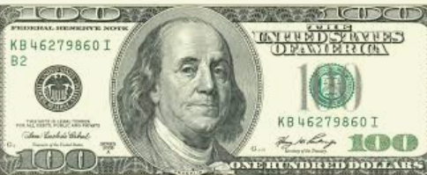
Audiences: Where to Devote Our Resources
May
AUDIENCE | DOLLAR AMOUNT
Prospective CCAs | $21.30
Farmers | $19.67
Employers | $17.88
Current CCAs | $12.81
College Students | $8.08
Early-Career (recent grads) | $7.18
Universities | $6.12
Members of Congress | $5.14
Regulators | $1.71
Primarily about Marketing & Promotion
Primarily about Delivering Value
Notes:
On our last call, a few weeks ago, I gave everyone an imaginary $100 bill and asked them to spend that $100 across key stakeholder groups.
This is how the group, collectively spent their $100.

Slide 8
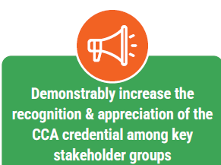
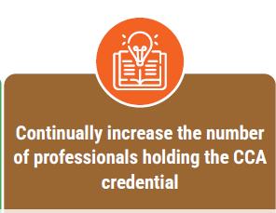
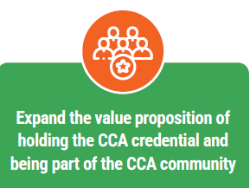
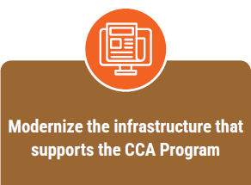
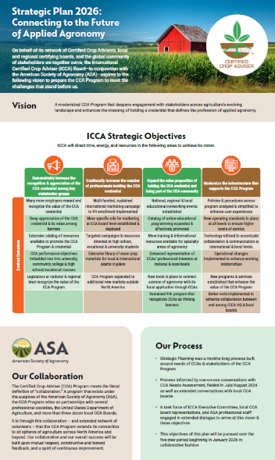













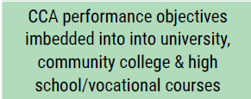
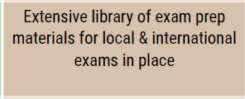

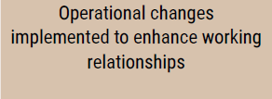
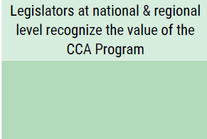
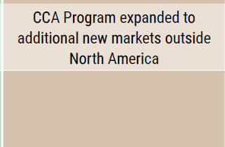



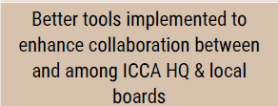
June

Slide 9
Pre-Mortem
July
It’s December 31, 2031. As the “strategic plan” the ICCA Board has “followed” over the past five years comes to a conclusion, no one could even tell you it’s expiring.
The “plan” never was put into action. There was no measurable progress across all of the four objectives.
Enrollment in the CCA Program continues to dwindle. The awareness of the CCA credential is at an all-time low. There’s really no difference in the value that CCAs receive for the holding the credential. And in terms of infrastructure, it’s same-old, same-old. Nothing’s really changed.
What went wrong?

Slide 10
What would lead to failure?
Lack of engagement across the org for executing the plan
Total lack of outreach effort (didn’t coordinate)
We can’t get employers on board (maybe don’t know enough about where our CCAs work)
Didn’t budget to put the time into it w/ different stakeholder groups
Failed to communicate the value proposition to stakeholders … with our succeeding board members (and turnover among staff not prepared) ***
Silo-d responsibilities (small group of people instead of wide-spread buy-in across boards)
* Across the board shared effort
Didn’t blow our horn enough in areas where we could pick up some clientele

Slide 11
What will breed success?
Engagement across the organization & collaboration
Coordinated, systemized outreach
Get a better idea of WHERE CCAs work & genuinely engage w/ their employers
Budget & allocate resources (money + time) to engage w/ key stakeholders
Sell our value proposition WAY better than we have
Everyone (“Madison” & all boards) are held accountable
* Comprehensive buy-in
Never miss (big) opportunities to blow our own horn

Slide 12
What would lead to failure?
No one took it on (no one spearheaded it)
One approach for all was done versus tailoring for markets (particularly int’l, but also regionally in U.S.) **
Didn’t build resources & infrastructure, esp looking at int’l spots where there’s language barrier ** (make it so easy)
Didn’t have name recognition …
States/provinces/countries so focused on awareness, overlooked opportunities to promote the program to exam takers (different in New Brunswick than in E. Lansing)
We put things out there in a trough, but weren’t aggressive at pushing people to utilize
Boards didn’t properly budget or don’t have money to implement (placed money elsewhere)
Didn’t allocate the right resources (big task and we failed to allocate accordingly) … talent at MSN or on boards
Failed to build the right teams to carry out the initiatives
Didn’t do our homework on the employment market & candidates who are using this to supplement their resumes

Slide 13
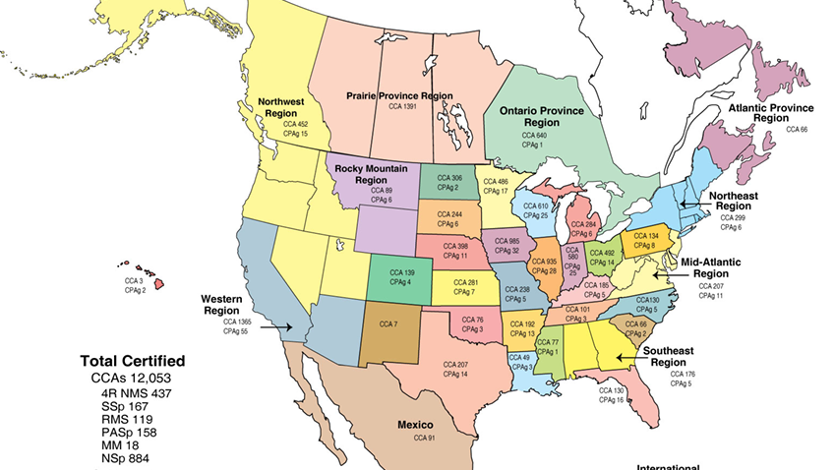
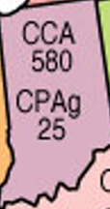
Better, consistent marketing WILL have impact
Population of Indiana: 7 million
Number of CCAs in Indiana: 580
Population of Manitoba, Saskachewan, Alberta: 7.6 million
Number of CCAs SHOULD be: 629
Instead? 1,391

Slide 14
What will breed success?
Relentless commitment from “Madison” & ICCA Exec Committee to never give up on this plan
Ensure that this scales down from International to Local (key role for local boards)
Ensure we understand the challenge and meet it
Create brand and name recognition
Local boards (& MSN) understand that awareness is different than direct marketing
Don’t just lead horses to water; make them drink (or give them IV fluids)
Budget as if this is a priority
Allocate the right resources at int’l and local levels
Create teams of staff/volunteers to generate ideas (w/o bureaucracy)
Do the homework, data analysis & qualitative research to ensure we know where the opportunities are

Slide 15
What would lead to failure?
Failed to constantly look at changes for how agronomists want to engage (leaving our annual programming the same as it’s always been) **
Failed to set up infrastructure for it and did poor job of putting together CCA trainings
Didn’t have research to implement on the ground
We didn’t understand our target audience, esp new & emerging agronomists
Got complacent and didn’t keep advancing on what’s coming down the tubes
Silo’d at regional level … didn’t share learning/content across regions, especially students & faculty
Didn’t seize opportunities to represent CCAs in front of significant opportunities … legislators, farmers, etc. (CCAs didn’t step for the opportunities)
Failed on communication … didn’t get the messaging to the right audiences
We failed to teach CCAs to be good liaisons between grower community & research community
Didn’t get buy-in from boards to take on this new challenge

Slide 16
What will breed success?
Continually monitor the needs of CCAs to ensure our programming matches their needs
Recognize that there is a fundamental need to change our infrastructure
Do the right research
Move beyond “Me-search;” genuinely understand our core stakeholders’ needs (CCAs)
Never be complacent: INNOVATE
Create systems to share ideas, resources across CCA boards
First understand key opportunities & put meaningful effort toward taking advantage of those opportunities
Don’t over-complicate; understand that this is about understanding the primary needs of CCAs & building programs that they WANT
Recognize that being an ambassador for the CCA Program won’t come naturally to CCAs; they must be trained & reminded
A completely new compact between ICCA & their local boards … bottom line expectations for what local CCA boards must do (w/ resources to support)
Literally or figuratively pursue the idea of “CCA membership”

Slide 17
What would lead to failure?
As we changed process, we didn’t make adjustments for those things that didn’t work
Didn’t equip admins and boards w/ easy-to-use technology (back and forth) ***
Didn’t eliminate things that needed eliminated (didn’t go sacred cow hunting)
  Didn’t engage w/ non-CCA stakeholders on what we could be doing better (ARA .. What do our employers want)
  Failed to persuade most resistant people to change
  Didn’t simplify policies & procedures
Local boards didn’t get a grasp of what the strategic plan meant (didn’t modernize/adapt contract/relationships w/ boards)
Didn’t budget the money
Weren’t transparent enough (w/ admins & boards)
Didn’t ask for input enough from admins (data, budget, status of CCAs)
From int’l perspective, translation (across the board)
Not taking a serious look at what we need to be going forward & making changes (hanging onto things too long)
Make sure key people understand the reasoning

Slide 18
What would breed success?
Be relentless in changing processes, but realistic & resilient as we do so
Equip local boards w/ appropriate communications & technological tools
Go sacred-cow hunting (Nothing’s Off the Table to Change)
  Emulate what other organizations are doing better than us
  Bring along the tough-to-convert; find new partners where necessary
  Simplify everything
Regularly reference & engage w/ local boards on strategic objectives (be accountable to each other)
Budget the money (and time)
Be mutually accountable to each other (MSN, local boards & admins)
Get input from local boards, always (and vice versa)
Translate for new int’l markets (including Canada?)
Refer back to #3
Make sure key people understand the reasoning (didn’t change this as it was already positive statement) … it’s what we’re doing RIGHT NOW

Slide 19

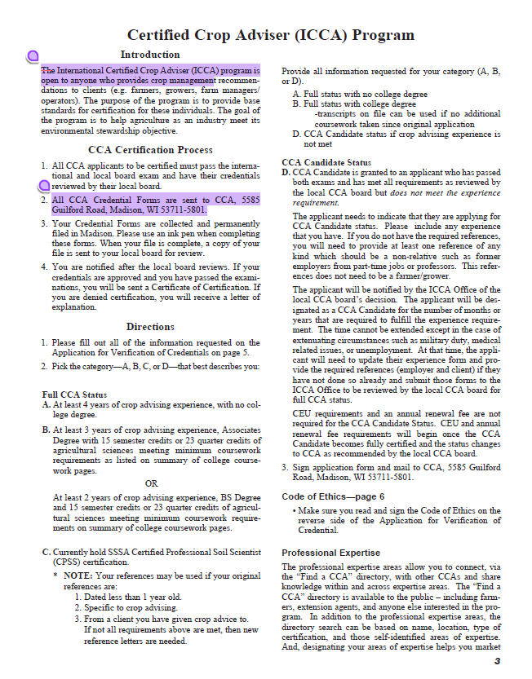
Acknowledgements
“Confronting the brutal truths”
Our technology platforms have not met an acceptable standard
Bad habit of bending technology around legacy processes
Didn’t have marketing dep’t to support last strategic plan
Too often, we left local/regional boards to fend for themselves
We have permitted under-performance by some boards
We’ve avoided tough decisions
Ready, shoot, aim approach to strategy
Didn’t back strategy up with resources & energy
We’ve permitted key stakeholders to have a less than optimal experience as candidates and as CCAs

Slide 20
1
Candidate
Candidate
HQ Reviews
Candidate Passes the Exam
HQ Sends Email w/ Attachments
26
24
2
3
Creates an Email
General App
Prints, fills out & scans
14
HQ Sends to Local Board
27
4
Employer prints, fills out, scans, emails
General App
Employer Reference
Forwards to Employer
15
16
25
5
17
Employer Reference
18
Local Board Reviews
28
Client Reference
Forwards to Client
Client prints, fills out, scans, emails
6
19
20
7
8
21
Client Reference
Code of Ethics
Prints, fills out, scans
10
9
Local Board Returns Approval to HQ
11
Code of Ethics
29
Experience Form
Prints, fills, out, scans
12
Univ locates transcript, emails
22
Experience Form
13
Contacts Univ for Transcript
23
HQ Notifies Candidate
30
Univ Transcript
How many phone calls & follow-up emails take place across all these steps?

Slide 21
Connecting to the Future of Applied Agronomy
The ASA 2026-31 Strategic Plan
Questions?
Comments?
Brilliant Ideas?

Slide 22
Great National & International Brands
(that transcend from nat’l or int’l basis to local and/or franchise level)

Slide 23
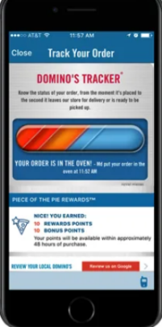


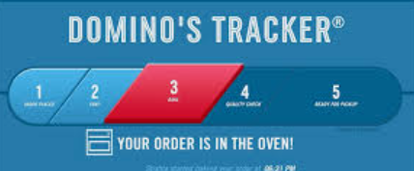
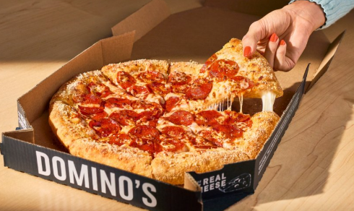
Fast delivery
Uniform brand identity
Localized toppings (paneer pizza in India)
Reliable digital ordering

Slide 24






Clear tiers of service across brands
Local cuisine integrated w/ experience
Local hospitality norms
Always a comfortable bed

Slide 25




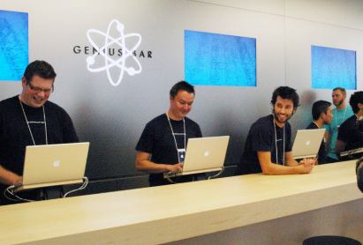
Exquisite attention to detail
Stores incorporate local architectural features & events
Genius Bar support
Stores contribute to – don’t take away – from the Apple brand

Slide 26

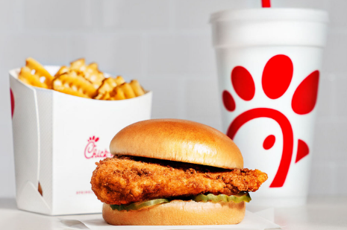
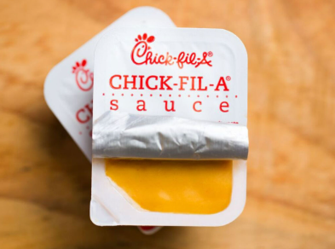
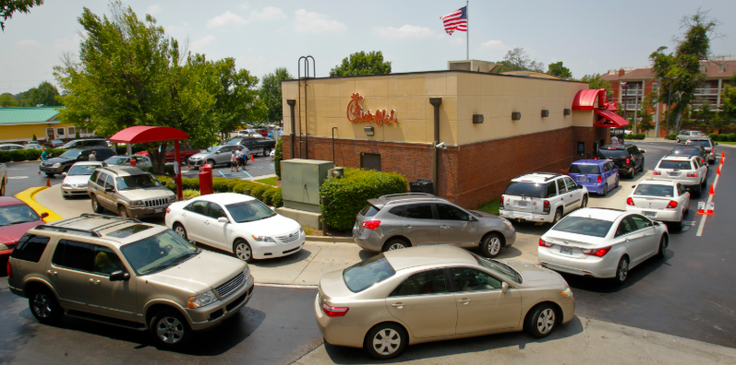
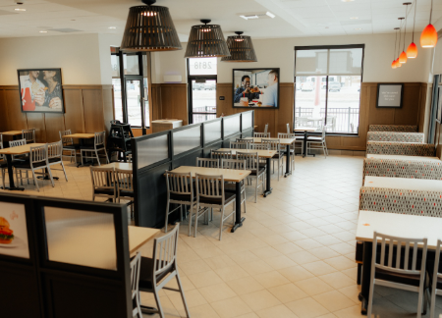

Extremely consistent customer service (“My pleasure”)
Food quality
Sponsoring local events
Operational playbook makes every location feel exactly the same—friendliness, clean, efficiency

Slide 27




Consistent standard of cleanliness
Décor, food, staff uniforms reflect local culture w/o compromising Marriott brand
Bring Ritz Carlton service to all of their brands

Slide 28




Comfortable ambiance
Consistent coffee quality
Barista culture
“Third place” brand experience—fostering social interaction, connection & a sense of community (different than home or work)
Notes:
he "Third Place" concept, popularized by Ray Oldenburg, refers to public gathering spaces that are distinct from home (first place) and work (second place). These spaces foster social interaction, connection, and a sense of community. Brands can leverage the Third Place concept to build deeper relationships with customers and cultivate loyalty by creating spaces that embody these values

Slide 29




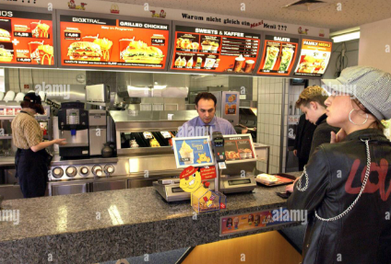
Strict standards for service, cleanliness & speed
Familiarity w/ a local twist
Golden arches
Menu staples

Slide 30






Common Threads across These Brands?
Clear brand standards (service, quality, look & feel)
Strong training & support for franchisees/operators
Technology integration (apps, loyalty systems) that unify experiences
Willingness to adapt culturally without compromising brand identity

Slide 31
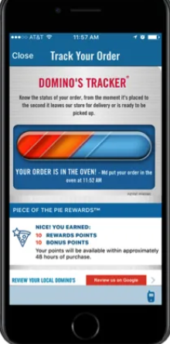


User & Brand Experience

Slide 32
Two-Part Exercise
What are world-class brands that deliver great, consistent experiences at the local or regional level?
What are attributes of the CCA brand that we want & how do we get there?

Slide 33
Things to Add
Ann’s stuff
ASA/CSSA/SSSA strategic plans
Member Hub
Practice exam
Study Guide, etc.
Bring in Good to Great (confront brutal truths, technology as accelerator, etc.)

Slide 34
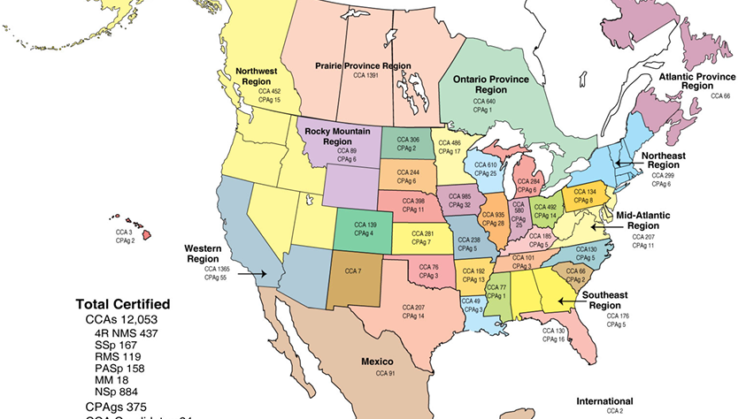
A New Era of Collaboration
@&%$#!!!!
“We’re developing an ad to place in local ag journal. Anyone have a template?”
“Who’s got a good CCA Powerpoint for a university audience?”
“@&%$#!”
“Madison”
“@&%$#!”
“@&%$#!”
“There are ad templates in our CCA Board resource center. Look here”
“@&%$#!”
“@&%$#!”
“We do. Here you go!"

Slide 35
ICCA/Board Compact
What (new) roles & functions will allow us to deliver on our new strategic plan

Slide 36

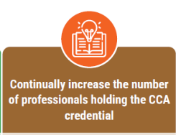

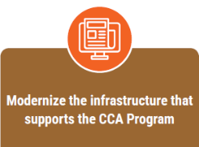












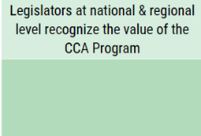
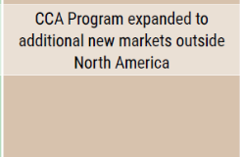



Slide 37
Bottom-Line Questions
What roles should local ICCA boards be filling generally?
What roles should local boards be filling to achieve the outcomes within our strategic plan?
What roles should ICCA HQ & Exec Committee be filling generally?
What roles should ICCA HQ & Exec Committee be filling to achieve the outcomes within our strategic plan?

Slide 38
Role of ICCA Boards
General Roles | Roles to Advance Strategic Plan Outcomes
Review CEUs | Breathing in life into specialty certs
rEview applicants | surveys
Promote the program | All board members make a presentation
Provide CEU opportunities | Providing an opportunity for community(at lerawt one)
Facilitate other ceu opps
Relationships with agencies & orgs, electd officials

Slide 39
Role of ICCA HQ & Exec Committee
General Roles | Roles to Advance Strategic Plan Outcomes
Manages exam, develops exma | Streamlines processes
Maintain database | Onboarding of board officers & admins
Moving toward standardization | Coordinate analytics
Temploats for promotional & mktg | Stakeholder engagement (elected officials, ARA,, employers)
General marketing of program
Customer service (1st point of contact) | Providing CEU opportunities
I.T. infrastructure | Cheerleaders for local boards
Communication & coordination w/ local boards | Templates for training materials
Manage finances | National prep materials
Promoting program & nat’l & int’l levels | Speakers bureau
Governance
Publishing

