Slide 1


Update:
Certifications Overview
Associate Director of Component Relations
Lara Bryant

Slide 2
Departmental Updates
Staffing changes
New Initiatives:
  Quarterly calls
  Admin and board training sessions and manual
  CCA Connect: Launching September 19th
  The Briefing: CCA Success Series, September 4th

Slide 3
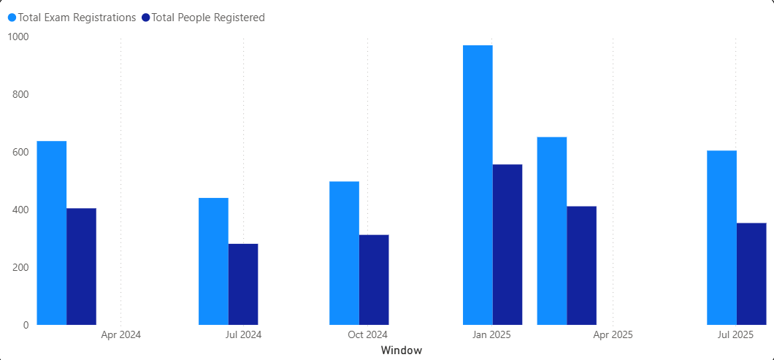
Total Exam Registrations
2024 = 997 people 2025= 1,320

Slide 4
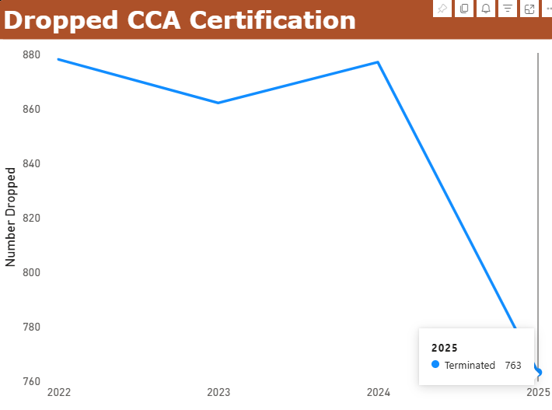

Slide 5
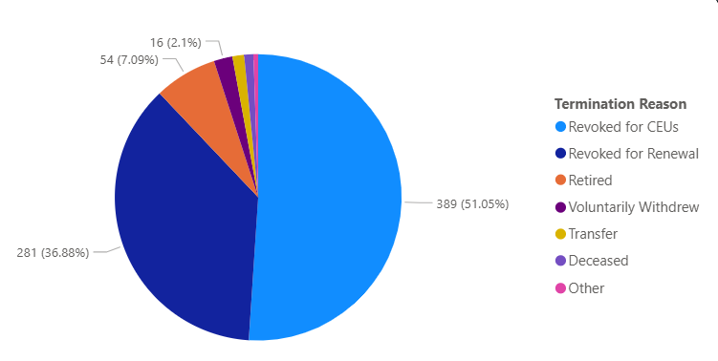
Termination Reason

Slide 6
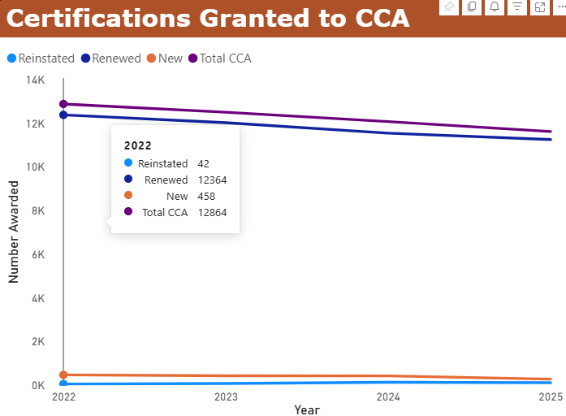
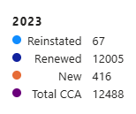
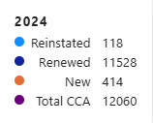
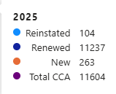
Avg – 3% loss per year

Slide 7
