Slide 1
Florida Citrus Update: Management of Huanglongbing Disease
Michael E. Rogers
Center Director & Professor
UF/IFAS Citrus Research and Education Center

Slide 2
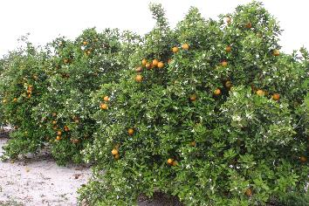
Citrus Management in Florida (USA) prior to introduction of HLB
Very Low Production Costs
3 fertilizer applications per year (N,P,K primarily)
2-3 petroleum oil sprays (mites & fungal diseases)
Herbicide applications (largest cost)
Notes:
So I’ll start off with how we previously grew citrus in Florida prior to the introduction of Citrus decline. Citrus was very easy to grow and required very low production inputs. IN a typical year, a grower would fertilize their grove 3 times per year. Most of the time, those fertilizer applications consisted of only N, P and K. Micronutrient applications were used occasionally, perhaps once a year to help with fruit set, but we didn’t apply micros that often.
As far as pesticide applications, most growers producing sweet orange for juice would make 2-3 petroleum oil applications per year to manage mites and foliar fungal diseases. Other insecticides were used primarily in case of fresh fruit to prevent cosmetic damage to fresh fruit.
Our largest expense in citrus at that time was herbicides for weed management.
Prior to Citrus decline, citrus was so easy to grow that many of our groves were owned by investors who did not live in Florida. They hired someone to fertilize the grove for them 3 times a year, make a couple of oil sprays and keep the weeds knocked back. Citrus production didn’t require much effort and returned very large profits. So that has changed quite a bit now with Citrus decline now endemic in Florida, growing citrus is more labor-intensive and expensive with growers struggling to even break even right now.

Slide 3
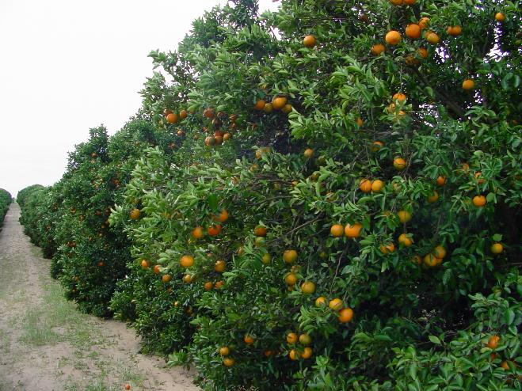
Notes:
So I’ll start off with how we previously grew citrus in Florida prior to the introduction of Citrus decline. Citrus was very easy to grow and required very low production inputs. IN a typical year, a grower would fertilize their grove 3 times per year. Most of the time, those fertilizer applications consisted of only N, P and K. Micronutrient applications were used occasionally, perhaps once a year to help with fruit set, but we didn’t apply micros that often.
As far as pesticide applications, most growers producing sweet orange for juice would make 2-3 petroleum oil applications per year to manage mites and foliar fungal diseases. Other insecticides were used primarily in case of fresh fruit to prevent cosmetic damage to fresh fruit.
Our largest expense in citrus at that time was herbicides for weed management.
Prior to Citrus decline, citrus was so easy to grow that many of our groves were owned by investors who did not live in Florida. They hired someone to fertilize the grove for them 3 times a year, make a couple of oil sprays and keep the weeds knocked back. Citrus production didn’t require much effort and returned very large profits. So that has changed quite a bit now with Citrus decline now endemic in Florida, growing citrus is more labor-intensive and expensive with growers struggling to even break even right now.

Slide 4
New problems associated with HLB (not a significant problem in Florida before HLB)
Leaf drop / thin canopy
Nutritional deficiencies
Yellowing of leaves
Small upright leaves
Branch dieback
Small misshapen fruit
Fruit drop
Asynchronous blooming pattern
Notes:
.

Slide 5
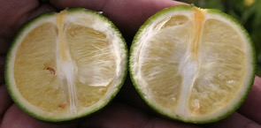
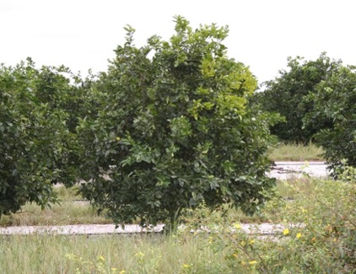
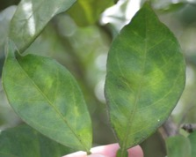
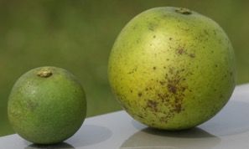
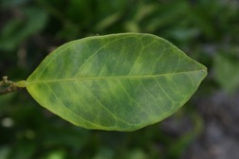
Early HLB symptoms in Florida

Slide 6
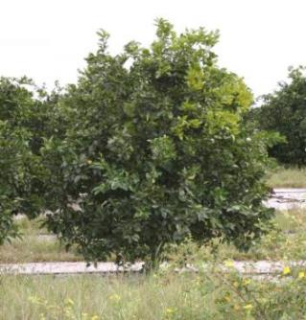
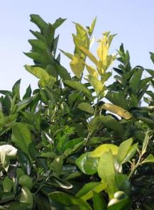
Effects of HLB on citrus in Florida
Yellow shoots/sector of tree

Slide 7
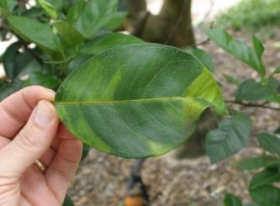
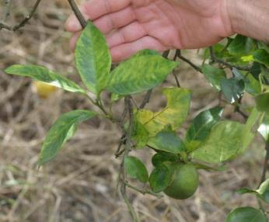
Effects of HLB on citrus in Florida
“blotchy mottle”
Asymmetrical chlorosis

Slide 8
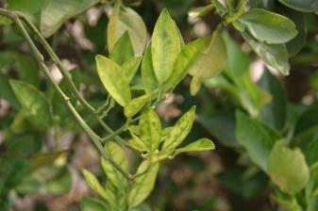
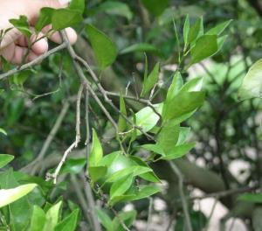
Effects of HLB on citrus in Florida
Small upright leaves

Slide 9
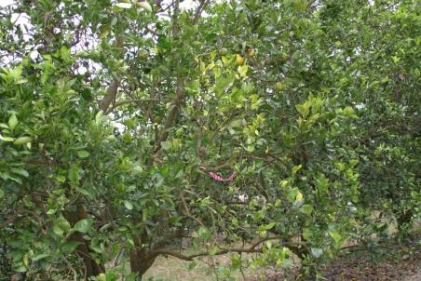
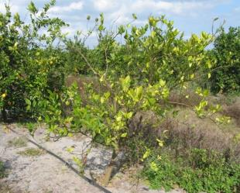
Effects of HLB on citrus in Florida
Leaf drop / twig dieback

Slide 10
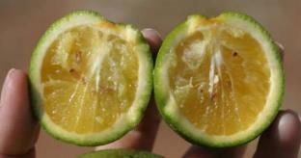
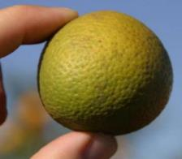
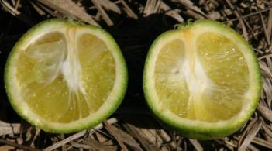
Effects of HLB on citrus in Florida
Small deformed fruit
Aborted seeds
Yellowing of columella

Slide 11
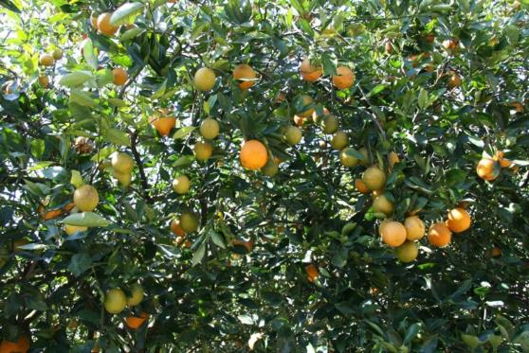
Effects of HLB on citrus in Florida
Asynchronous bloom leading to fruit of different maturity stages
Notes:
.

Slide 12
Effects of HLB on Florida Citrus Round Orange Production (2005 – 2024)
Production area
Fruit Yields
242 million boxes
344,350+ ha
9,879,241 tons
68% decrease
91.5% decrease
< 111,169 ha
20.5 million boxes
836,877 tons
Indonesia 2019: 73,083 ha = 2,563,486 tons
Notes:
Here’s what’s happened to the Florida citrus industry over the past 19 years. Our citrus production area has gone from more than 344,000 hectares to less than 238,000 hectares. And annual fruit yields have dropped from a high of 242 million boxes of oranges to a forecasted 20.5 million boxes this season. That’s over a 90% reduction in our yields due to citrus decline. But that 20.5 million box number is actually an increase from last season. We’ve been making progress turning things around based on what we’ve learned about citrus decline and growers are now implementing many new management practices in their groves which I’m going to talk a little bit about.

Slide 13
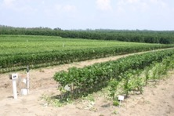
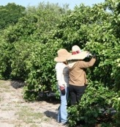
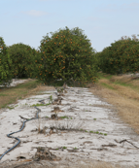
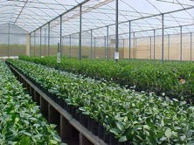
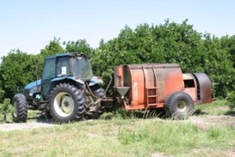
Florida’s Initial Response to HLB
Protected Nurseries
Scouting & removal of trees with decline
Psyllid control
Notes:
When Citrus decline first arrived in Florida, our response was to try and slow the spread of the disease. This included removing infected trees, spraying insecticides up to 12 times per year to keep psyllid populations low, and the mandate that all citrus nursery material be grown in pathogen-free green house structures.
19 years later, all or our groves have citrus decline, so we are no longer removing infected trees, or spraying 12 times per year for psyllids. But it does remain important to start off with disease free trees at the time of planting. So our nursery industry does remain under screen to isolate nursery trees from diseases prior to planting.

Slide 14
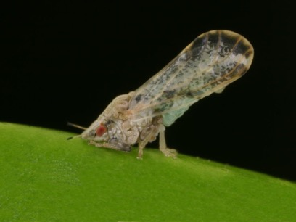
Psyllid Management
Florida growers initially spraying 12+ times per year for psyllids
What’s the best approach for managing psyllid populations?

Slide 15
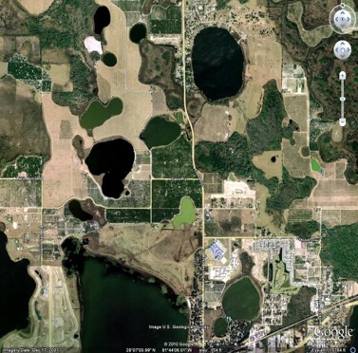
Psyllid Management
1.24 miles
0.75 miles
(Stelinski)

Slide 16
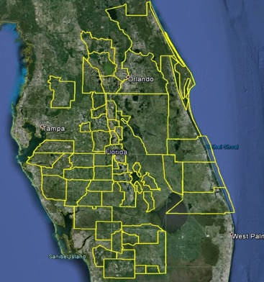
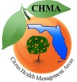
Area-Wide Psyllid Management
Citrus Health Management Areas (CHMAs)
197,000 hectares of commercial citrus

Slide 17
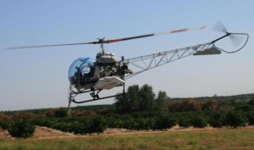
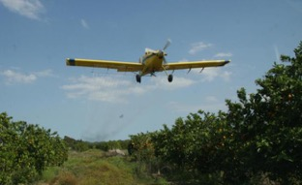
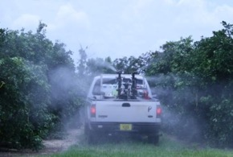
Pesticide Application Methods

Slide 18
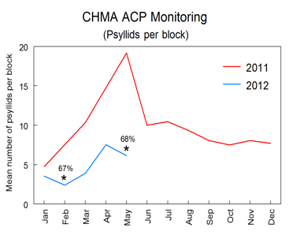
Area-Wide Psyllid Management
Played a key role in managing pesticide resistance development (regional MOA rotation)
*30 CHMAs established in 2012

Slide 19
The END of Area-Wide Psyllid Management in Florida
Area-wide management wasn’t adopted until 8-9 years after HLB was found
Disease had already spread and yields began to drop
Growers shifted their limited funds to other tools believed to be effective, but ultimately failed
Foliar antibiotic sprays

Slide 20
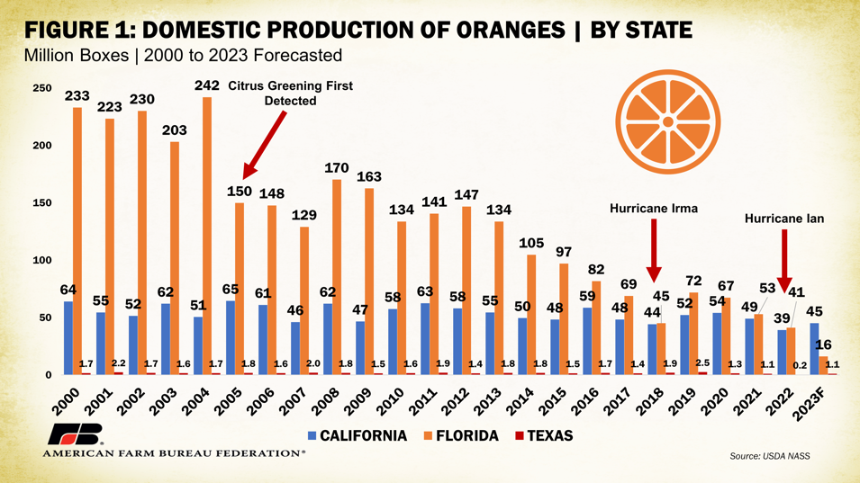
3 hurricanes

Slide 21
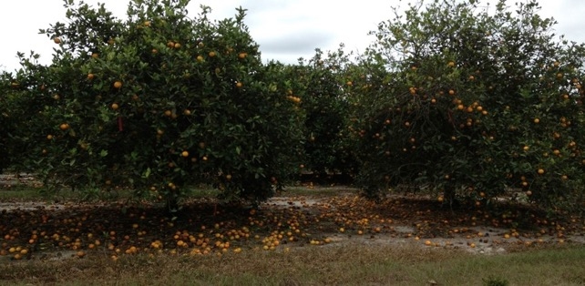
Fruit Drop (2012)
Yields fall below 100 million boxes by 2015

Slide 22
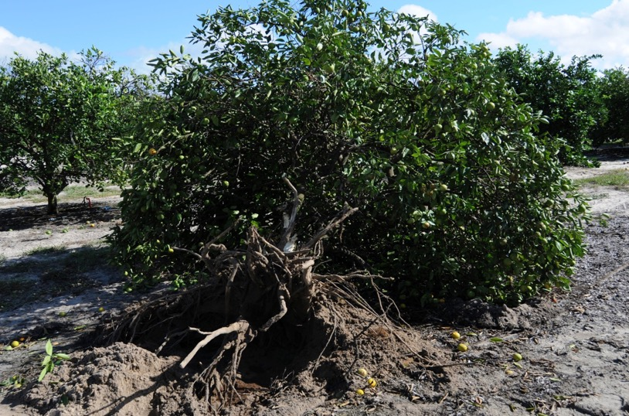
Notes:
This is just a close up of the Root system of a tree with decline in Florida which is lacking the fibrous mat of roots that uptake water and nutrients, mostly just structural roots remain. This photo was taken back in 2010 and if you pulled up some trees nearby that were not yet affected by decline, you would see a much healthier root system with many of the fine roots still present that take up water and nutrients. So the first thing that happens with decline is you start to lose the fibrous roots that limit water and nutrient uptake which then leads to a cascade of other events in the tree resulting in tree decline and lower yields.

Slide 23
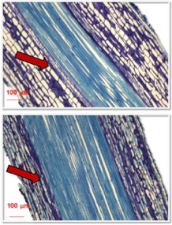
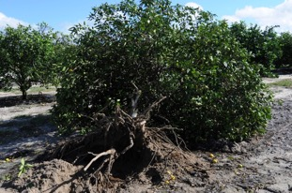
HLB Effects on Root Health
UF/IFAS researchers discovered 30-40% root loss before above-ground symptoms apparent; limiting nutrient and water uptake
HLB
HLY
Notes:
Much of what we’ve learned begins with the understanding that HLBhas serious effects on citrus root health. Our researchers discovered that 30-40% of a trees roots were lost due to decline before any above ground symptoms were apparent.
This is important because it significantly affects the ability of trees to take up water and nutrients needed to maintain tree health, yields and good fruit quality.

Slide 24
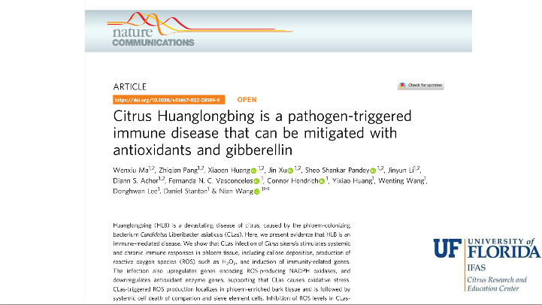
How the HLB pathogen causes disease
(Nian Wang)
Nature Communications 13 (1), 529 (2022)
https://doi.org/10.1038/s41467-022-28189-9
Notes:
So starting with the understanding that effects on the root system really drives a lot of the disease symptoms we see with decline, our research has focused on ways to live with this disease.
So I’ll talk about what’s working in Florida right now?

Slide 25
How the HLB pathogen causes disease
(Nian Wang)
Notes:
So starting with the understanding that effects on the root system really drives a lot of the disease symptoms we see with decline, our research has focused on ways to live with this disease.
So I’ll talk about what’s working in Florida right now?

Slide 26
How the HLB pathogen causes disease
(Nian Wang)
Notes:
So starting with the understanding that effects on the root system really drives a lot of the disease symptoms we see with decline, our research has focused on ways to live with this disease.
So I’ll talk about what’s working in Florida right now?

Slide 27
How to Survive with Endemic HLB?
What’s working in Florida?
Notes:
So starting with the understanding that effects on the root system really drives a lot of the disease symptoms we see with decline, our research has focused on ways to live with this disease.
So I’ll talk about what’s working in Florida right now?

Slide 28
Psyllid Management
Where HLB is endemic:
Low levels of psyllids can be tolerated
Control needed when populations increasing to high levels
Notes:
And as far as psyllid management goes, we are no longer spraying 12 times per year for psyllids since we are not trying to slow disease spread. Citrus decline is everywhere in Florida now. Our research has shown that under endemic decline situations, low levels of psyllids can be tolerated. Its when psyllid populations start increasing rapidly that sprays are needed to prevent damage to the trees. This requires routine monitoring of psyllids and typically 2-3 sprays for psyllid control per year in Florida.

Slide 29
Timing using thresholds (Stelinski Lab)
Economic Injury Level of 0.2 ACP/ tap =
average of 10 trees sampled
Beginning of the season
End of the season
Threshold
triggered
Threshold
triggered
Winter
Winter
0.2
Average ACP / tap
Area under the threshold line is where biological control provides benefit
0.15
0.1
0.05
Growing season
Spray on visible flush if/when ACP reappear
Keep in mind
Idea is to minimize stress on trees to boosts yield via improved health
This graphic will look very different depending on when your grove flushes; the technique is meant to be malleable to changing conditions
Spray at budbreak and before new flush is present
Photo: D. Hall
Dormant sprays should achieve 60+ days of low ACP populations

Slide 30
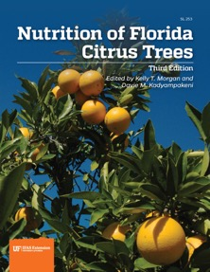
Importance of Proper Fertilization
Proper balance of macro- and micro- nutrients
Improve canopy growth
Increase fruit size and quality
Can reduced ROS production
Need to adjust timing and amounts of fertilizer applied…”spoon feeding”
Sandy soils in Florida
Google: “SL 253”

Slide 31
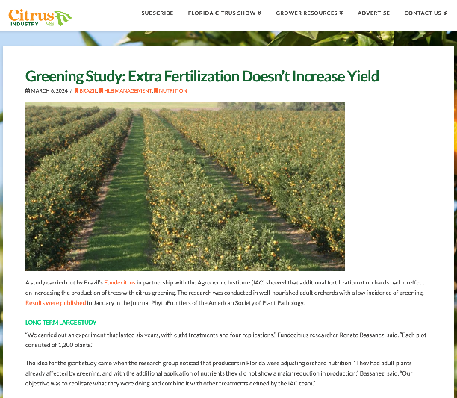
Study conducted (2010-2016) in grove with low HLB incidence/severity already receiving adequate nutrition
Different situation than in Florida where disease is severe and nutrient uptake is reduced due to compromised root system

Slide 32
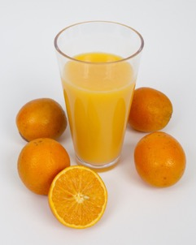
Fertilization Affects Fruit Quality
Ensuring proper nutrient balance can improve fruit quality on HLB-diseased trees (Vashisth & Wang)
58
2
Optimized Nutrition
Standard grower Nutrition

Slide 33
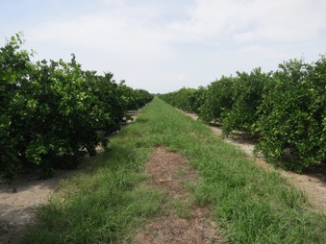
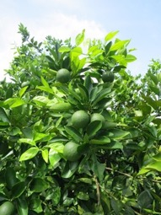
Improving Root Health / Performance
Proper soil pH (5.8 – 6.5) needed for optimal nutrient uptake by root system
2 ½ years after soil acidification, yields improved significantly
(Graham & Johnson)

Slide 34
Importance of Proper Irrigation
Florida sandy soils have very low water holding capacity
Failure to maintain adequate soil moisture levels starting at fruit set will impact fruit growth and retention later in the year.

Slide 35
Importance of Proper Irrigation

Slide 36
(Irrigation Timing)
(Vashisth)

Slide 37
(Vashisth)
(Irrigation Timing)

Slide 38
Reducing HLB-Induced Oxidative Stress
Oxidative stress can be reduced with properly timed application of plant hormones (PGRs)
Gibberellic acid
2,4-D
Cytokinin
Boost plant growth and reduce fruit drop
Tang and Vashisth 2020. Scientia Horticulturae 265, 109246
Singh et al., 2022. HortScience 57(3): 353-359.

Slide 39
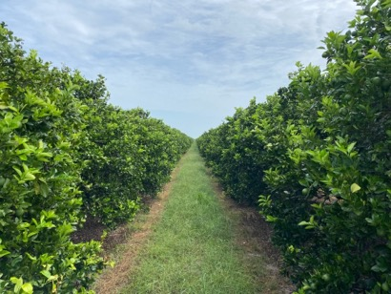
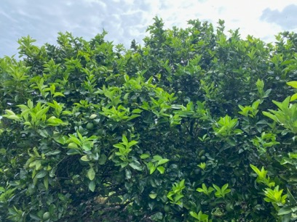
Results of new grove management practices
Notes:
So with proper attention to all these factors, many of our growers are having success in rejuvenating groves with endemic citrus decline. This is a picture of one such grove and the trees look very similar to what a grove in Florida looked like 20 years ago before citrus decline…so this can be done!

Slide 40
Research Goal for the Future
Development of HLB Resistant Citrus Varieties
Conventional citrus breeding
Biotech approaches
Transgenics, Cisgenics, etc…
CRISPR (gene-editing)

Slide 41
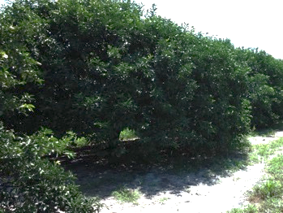
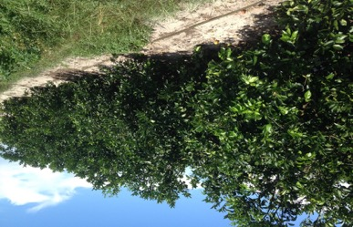
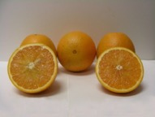
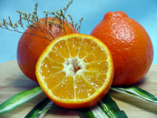
Conventional Breeding
‘Sugar-Belle’ mandarin
‘OLL-8’ sweet orange

Slide 42
Transgenic HLB-Tolerant Varieties
Numerous transgenic lines have been developed and are being evaluated for tolerance / resistance to HLB
Scions and rootstocks
Florida citrus industry now supportive of transgenic citrus if it works!

Slide 43
Efforts to Release First Transgenic Citrus Varieties
‘Hamlin’ sweet orange (5 lines); ‘Duncan’ grapefruit (1 line)
Expressing Arabidopsis NPR1 protein
Do become infected with HLB-causing bacterium
Significantly fewer HLB symptoms observed in field
Recently approved for release by USDA, now must get approval from US EPA for commercial release

Slide 44
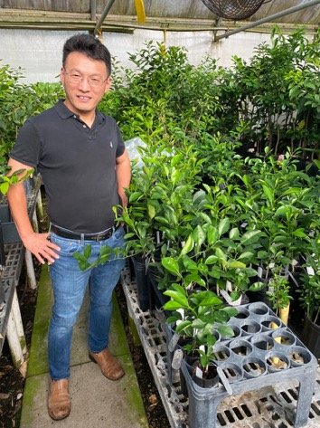
1st gene edited (non-transgenic) citrus lines developed
CRISPR-edited ‘Hamlin’ orange (Dr. Nian Wang)
Resistant to bacterial citrus canker
Xanthomonas citri ssp. citri
Full regulatory approval has been received for commercial planting
First CRISPR-edited crop of any type approved for release in the U.S.!
CRISPR-edited lines for resistance to HLB are underway

Slide 45
How to Survive with Endemic Citrus Decline?
Prioritize proper fertilization and irrigation practices
Cultural practices to improve soil/root health
Reduce oxidative stress within trees
PGR’s – GA, 2,4-D, cytokinins, micronutrients
Keep psyllid populations in check
Plant varieties/rootstocks with better tolerance to HLB

Slide 46
University of Florida Online Citrus Resources
https://citrusresearch.ifas.ufl.edu
Notes:
With that, I thank you for your attention and look forward to hopefully seeing you again soon in person next time I’m able to make a visit. Thank You!

