Slide 1
ICAA
Board Meeting
Donnie Taylor
Senior VP of Member Services & Corp Relationships
August 20, 2025

Slide 2
Mission Statement
The Agricultural Retailers Association (ARA) unites its members and their interests to advocate and educate on their behalf, provide services to improve their businesses, and preserve their freedom to operate and innovate, ensuring a safe and plentiful food supply for all.

Slide 3
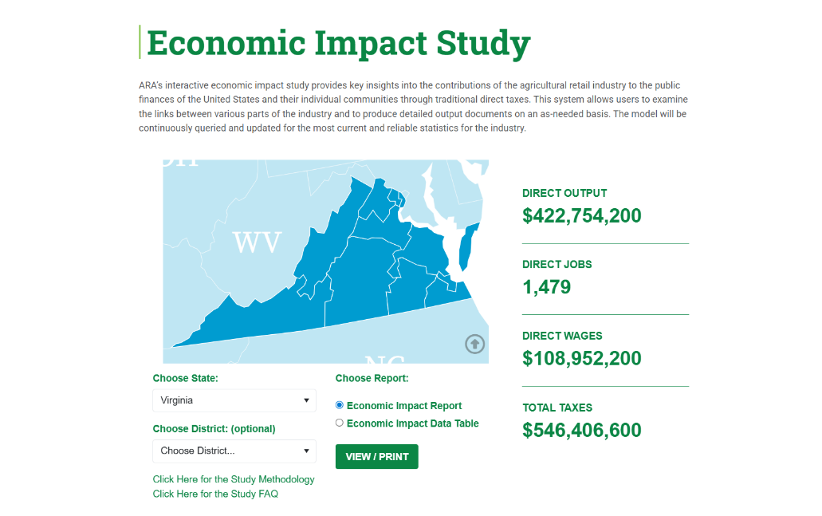

Slide 4
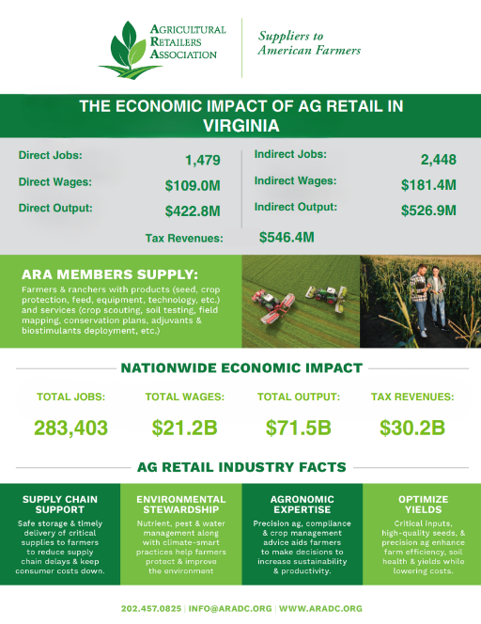

Slide 5
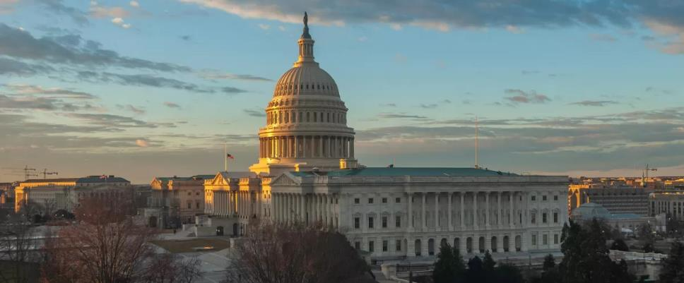
If you’re not at the table, you’re on the menu.

Slide 6
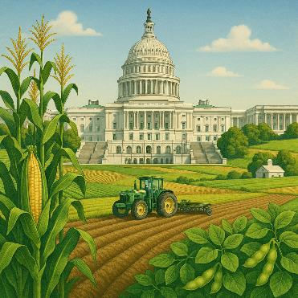
What is going on in DC?
One Big Beautiful Bill
Farm Bill
National Farm Security Action Plan
MAHA Commission Report
Transportation Issues
EPA ESA Pesticide Mitigation Measures

Slide 7
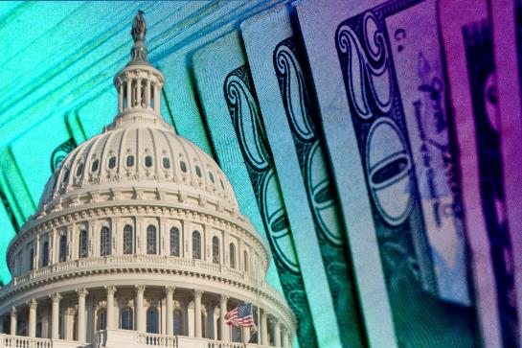
These tax provisions directly support ag retail operators by:
Reducing tax burden on small- and mid-sized businesses.
Encouraging investments in equipment, new facilities, and technology.
Helping transition family-owned operations smoothly to the next generation.
Supporting involvement in growing markets like biofuels

Slide 8
One Big Beautiful Bill – Tax Provisions
Other ARA tax priorities included in the OBBB:
Stepped-Up Basis
Preserved in full.
Heirs can continue to inherit assets at fair market value, avoiding capital gains on appreciated value prior to inheritance.
This protects family-owned farms, ag retailers, and small businesses from facing immediate tax burdens on inherited land or equipment.
Like-Kind Exchanges (1031)
Fully preserved for real property.
Landowners and businesses can still defer capital gains taxes when swapping land or other qualifying real estate for similar property.
Critical for farm transitions, infrastructure reinvestment, and land consolidation.
20% Long-Term Capital Gains Rate
Remains unchanged.
The top capital gains tax rate for long-term investments remains at 20%, plus the 3.8% net investment income tax (for higher earners).
This maintains a favorable environment for investment in farmland, facilities, and business assets.

Slide 9
One Big Beautiful Bill – Farm Bill Provisions
Commodity Price Supports & Safety Net
Extension of core programs — PLC, ARC, marketing assistance loans, and Dairy Margin Coverage extended through 2031, preventing lapse into outdated permanent law
Higher reference prices — boosted by approximately 11–21%, with an automatic escalator of +0.5% per year (capped at 113–115%)
ARC modifications — increased benchmark revenue cap and higher coverage (85→90%), inclusion of 12.5% benchmark in payments
Dairy Margin Coverage improvements — coverage limit raised to 6 million lbs, plus a one-time 25% premium discount for 2026–2031

Slide 10
One Big Beautiful Bill – Farm Bill Provisions
Crop Insurance & Risk Management
Enhanced crop insurance — 90% multi-commodity coverage introduced; premium support increased; extended priority for beginning farmers (5→10 years)
Livestock disaster aid — new safety-net payments covering 75% of market value losses due to weather or disease
Marketing assistance loans increased for covered commodities (2026–2031)
Acreage Flexibility & Payment Limits
Voluntary new base acres — up to 30 million acres in 2026 for farms expanding; includes non-covered crops up to 15%
Higher payment limits — commodity program cap raised from $125K → $155K (with inflation), and s-correlation exclusions for S corps & LLCs
Adjusted AGI threshold — entities with >75% farm income exempt from the $900K AGI cap

Slide 11
One Big Beautiful Bill – Farm Bill Provisions
Conservation Funding
Redirected IRA funds — shifting unspent Inflation Reduction Act funds into USDA’s farm bill baseline from 2026–2031
Support for EQIP, CSP, ACEP, & RCPP — new baseline funding, though broader climate targeting removed .
Research
Reauthorizes “stranded” farm programs — e.g. 1890 Scholarships, National Organic Cost‑Share, and Organic Data Initiative
Specialty crop investment — public support for apples, nuts, pulses, citrus, sugar, sorghum, barley, etc., including boosted research, export funding, and updated safety nets
Research and market promotion — double-funding for MAP/FMD, grants for modernization, and stronger trade/export programs across commodities

Slide 12
Rescissions Package
What Is the Rescissions Package?
It’s a bill (H.R. 4) from President Trump requesting Congress cancel $9billion in previously approved spending.
Main targets:
  Around $7 billion in foreign aid (USAID, global health, migration, disaster relief, etc.)
  Also cuts about $1 billion for public broadcasting (NPR/PBS)
The package is unlikely to affect farm programs directly, but could impact global ag aid, conservation, and research.
Senators want transparency—waiting for details before committing.
If passed, the cuts are final and permanent—restraining future funding for certain programs.
Congress approved the recissions package on July 18 —otherwise the funds must be released

Slide 13
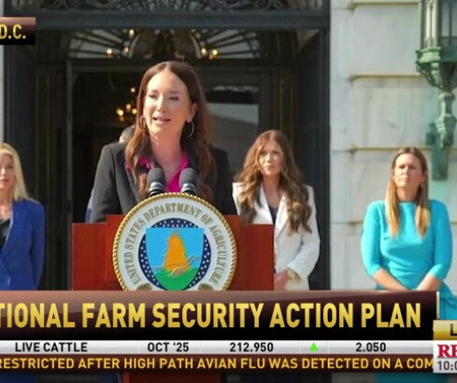
National Farm Security Action Plan
What It Could Mean for Agriculture
Increased awareness and support for protecting critical ag inputs and systems.
More federal resources for ag retailers, co-ops, and processors to boost site security and digital protections.
Possible new compliance expectations, especially for larger operations tied into national supply chains.

Slide 14
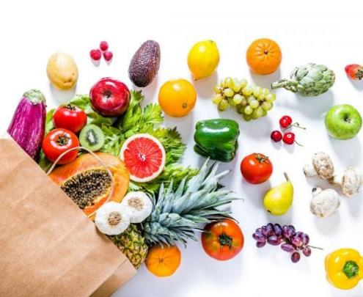
Make America Healthy Again (MAHA) Commission Report
Overview
The MAHA Commission report issued on May 22, 2025, raises pressing concerns about the use of pesticides in American agriculture, particularly focusing on the implications of unreliable citations and the proliferation of junk science in shaping public policy and agricultural practices. These issues have spotlighted vulnerabilities within the regulatory and scientific evaluation processes, undermining informed decision-making and public trust.
Misleading and False Citations
One of the central criticisms outlined in the report is the pervasive use of misleading and false citations in studies and publications advocating for pesticide usage. These citations often distort the findings of original research or reference outdated, irrelevant studies to substantiate claims. This practice weakens the credibility of the scientific discourse surrounding pesticide safety and efficacy, creating confusion among policymakers, farmers, and consumers.

Slide 15
MAHA Report Makeup
Pesticides
Source: CropLife America

Slide 16

MAHA Commission Report: Consequences for Public Perception
For the general public, the prevalence of false citations in pesticide-related reports fosters mistrust toward scientific institutions and government agencies. This erosion of confidence can hinder educational efforts and the adoption of safer agricultural practices, ultimately affecting both consumer behavior and industry standards.

Slide 17
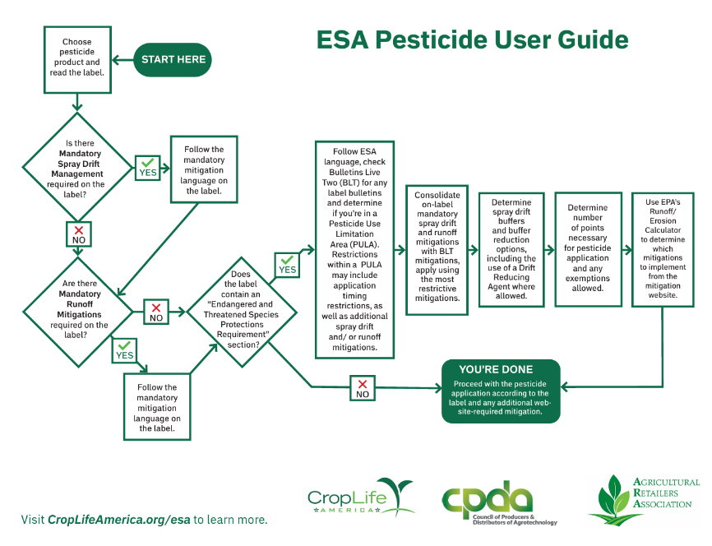

Slide 18
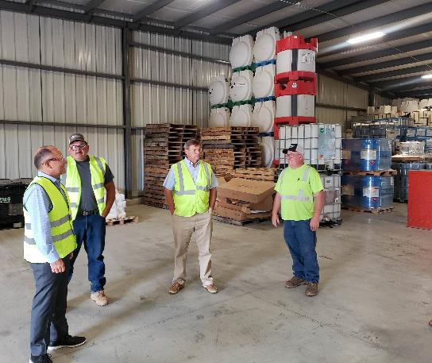
Congressional Facility Visits
Link the Industry to the Economy & Jobs
Highlight a Specific Issue or Initiative
Explain Impacts of Proposed or Enacted Legislation
Clarify a Complex or Technical Issue
Preview, Prepare facility and people ahead of time

Slide 19
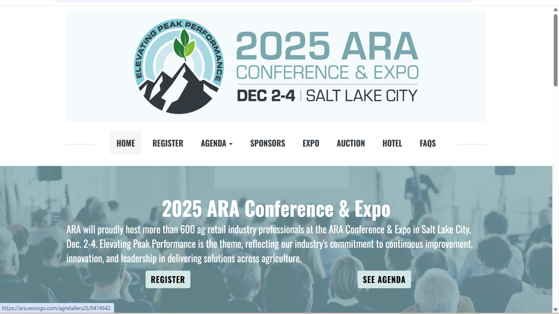

Slide 20










Why ARA?
Leverage and magnify your Voice
Networking opportunities
Up-to-the-minute updates from Capitol Hill and regulatory agencies
Influence policy outcomes
Expand knowledge network
Industry visibility
Professional development programs
Be recognized for achievements
Cost effective extension of staff
Leadership opportunities

Slide 21





Connect with the Agricultural Retailers Association (ARA)
Contact us at info@aradc.org.
Go to www.aradc.org to learn more.
Follow us on social media.
4201 Wilson Blvd. Suite 700 Arlington, VA 22203 T 202.457.0825

