Slide 1


AGROLOGISTS
IN
CANADA

Slide 2
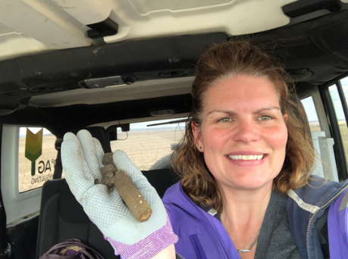
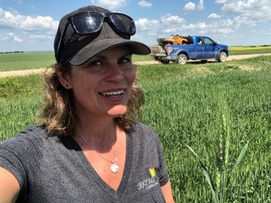
AGROLOGISTS
ARE
LICENSED
PROFESSIONALS
WHO PRACTICE AGROLOGY

Slide 3


SYSTEM IN PLACE TO PROTECT THE PUBLIC
Agrologists need to be licensed when advising in food production/environmental protection
Technical Competency and Ethical Behavior

Slide 4

AGROLOGY
IS A PROVINCIALLY REGULATED PROFESSION ACROSS
EVERY PROVINCE HAS ITS OWN AGROLOGISTS ACT, REGULATORY BODY AND REGISTRATION REQUIREMENTS
EACH PROVINCIAL INSTITUTE (9) REGULATES ITS REGISTERED MEMBERS TO ENSURE THEY PROVIDE THE PUBLIC WITH SAFE, COMPETENT AND ETHICAL PRACTICE.

Slide 5

Ensures that agrology professionals, certified in any province, are able to have their qualifications recognized across Canada
labour mobility
Delivers key messages to inform the Candian public about agrology and agrology professionals
Agrology professionals are stewards of modern agriculture who help Canada rise to the challenge of doing more with less for safe and useful products for society.

Slide 6
AGRONOMIST OR AGROLOGIST?
THE TERMS AGRONOMY AND AGROLOGY SOUND VERY SIMILAR AND ARE SOMETIMES USED INTERCHANGEABLY.
IN THEY ARE UNIQUE TERMS WITH SPECIFIC MEANINGS
A BROAD TERM, AREA OF A SPECIFIC AGROLOGY PRACTICE
REFERS TO A SCIENCE-BASED REGULATED PROFESSION
REFERS TO THE SCIENCE OF SOIL MANAGEMENT AND CROP PRODUCTION
AGROLOGY
AGRONOMY

Slide 7


MANITOBA GOVERNMENT
THE AGROLOGISTS ACT
Practicing Agrology: includes every act with or without reward, which has at its objective the experimentation with or the giving of advice with respect to the principles, laws, or practices relating to the production, improvement, use, processing or marketing of agricultural products, crops or livestock

Slide 8

THE ACT IS THE RIGHT TO PRACTICE
REGISTRATION IS REQUIRED TO LEGALLY PRACTICE AGROLOGY
PROFESSIONAL AGROLOGIST (P.AG)
TECHNICAL AGROLOGIST (TECH.AG)
AGROLOGIST IN TRAINING – RESTRICTED USE
If you meet MINIMUM EDUCATION STANDARDS - you can be licensed
DESIGNATIONS AND TITLES

Slide 9
EXAMPLES:
AGRONOMIST
ANIMAL NUTRITIONIST
AG MARKETING
NOT A CLUB
NOT TRYING TO GET MEMBERS
NO NETWORKING OPPORTUNITIES

Slide 10






REGULATOR
VOLUNTARY
ASSOCIATION
Agrologists Manitoba
CCA
LAW
NO LAW
PROTECTS THE PUBLIC
SUPPORTS MEMBER’S CAREERS
VALUABLE LEARNING OPPORTUNITIES
DESIGNATION - PUBLIC BENEFIT
DESIGNATION - MEMBER BENEFIT
EXCELLENT ADDITIONAL TRAINING

Slide 11
REGULATOR
VOLUNTARY
ASSOCIATION
Agrologists Manitoba
CCA
ALL AREAS OF AGRICULTURE
FOCUSED ON CROP PRODUCTION
POST SECONDARY REQUIRED
POST SECONDARY NOT REQUIRED
NO TESTING
STANDARDIZED TESTING
AREAS OF PRACTICE
CEU REQUIREMENTS
ADHERE TO HIGH LEVEL OF INTERGRITY AND ETHICS
ON GOING EDUCATION AND PROFESSIONAL DEVELOPMENT
In MB, Full-Status Agrology Professionals record examples of effort towards remaining competent, there is not a specific time/hours/credit requirement.
$400
CDN
YEARLY FEE
ONLINE SEARCHABLE MEMBER DIRECTORY
Notes:
one year of canadian experience
application fee
mentorship certification
jursiprudence and ethics
AGM
provide transcript
vs
2 years- 4 years crop advising experience
provide transcript
exam fees
registration fee
letter from employer
letter from farmer

Slide 12
REGULATOR
VOLUNTARY
ASSOCIATION
Agrologists Manitoba
CCA
ONE YEAR OF CANADIAN EXPERIENCE
2 - 4 YEARS OF CROP ADVISING EXPERIENCE
PAY APPLICATION FEE
REGISTER & PAY EXAM FEES
MENTORSHIP CERTIFICATION FORM
SUPERVISOR & CLIENT REFERNCE LETTER
JURISPRUDENCE & ETHICS SEMINAR & ASSIGNMENT
SIGN & AGREE CCA CODE OF ETHICS
PROVIDE TRANSCRIPT
PROVIDE TRANSCRIPT
Notes:
one year of canadian experience
application fee
mentorship certification
jursiprudence and ethics
AGM
provide transcript
vs
2 years- 4 years crop advising experience
provide transcript
exam fees
registration fee
letter from employer
letter from farmer

Slide 13

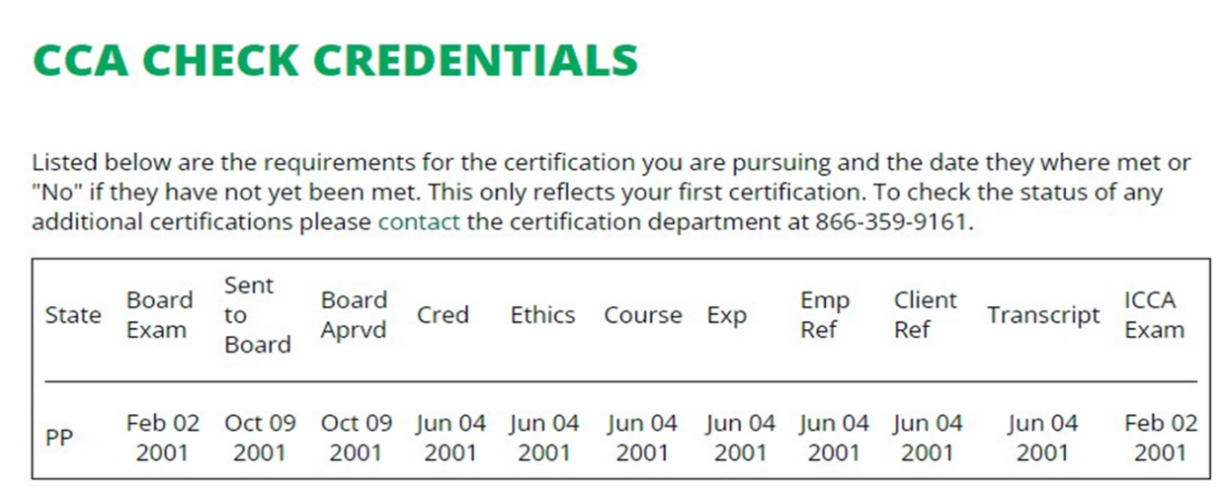
PRACTICING WITHOUT BEING REGISTERED IS ILLEGAL

Slide 14



When they do identify someone, who may be in breach of “The Agrologists Act”, they make contact with the person or employer, determine what the situation is, and point to registration requirements if the circumstances warrant.
They have found that some individuals are unaware of the difference between the license/registration requirement, and a voluntary certification that may assist in marketing products and services.
It is also worth noting that individuals (not companies) are accountable under “The Agrologists Act” of Manitoba.

Slide 15

AT THE CORE OF AGROLOGY THERE IS AN UNDERSTANDING OF AGRICULTURE AND AGRI-FOOD, THE ENVIRONMENT AND THE ECONOMY.
THE PUBLIC RELIES ON AGROLOGY PROFESSIONALS FOR THEIR ETHICAL LEADERSHIP IN PROVIDING SUSTAINABLE, SCIENCE-BASED SOLUTIONS AND ADVICE.
Agrology professionals help feed Canada and the world, protect the environment, and boost the economy.

Slide 16
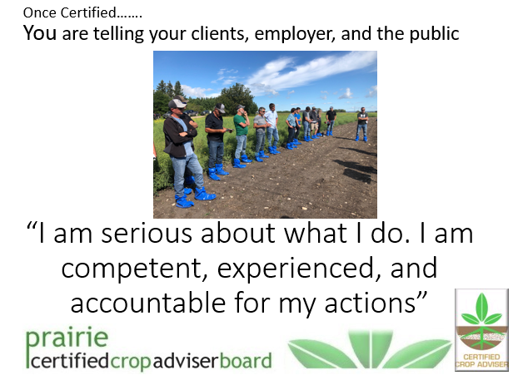
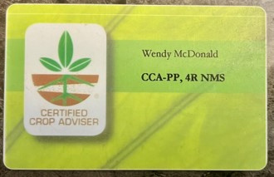

Slide 17








THANK
THANK
YOU
YOU
Vice Chair Prairie Certified Crop Advisers

